Slide 1
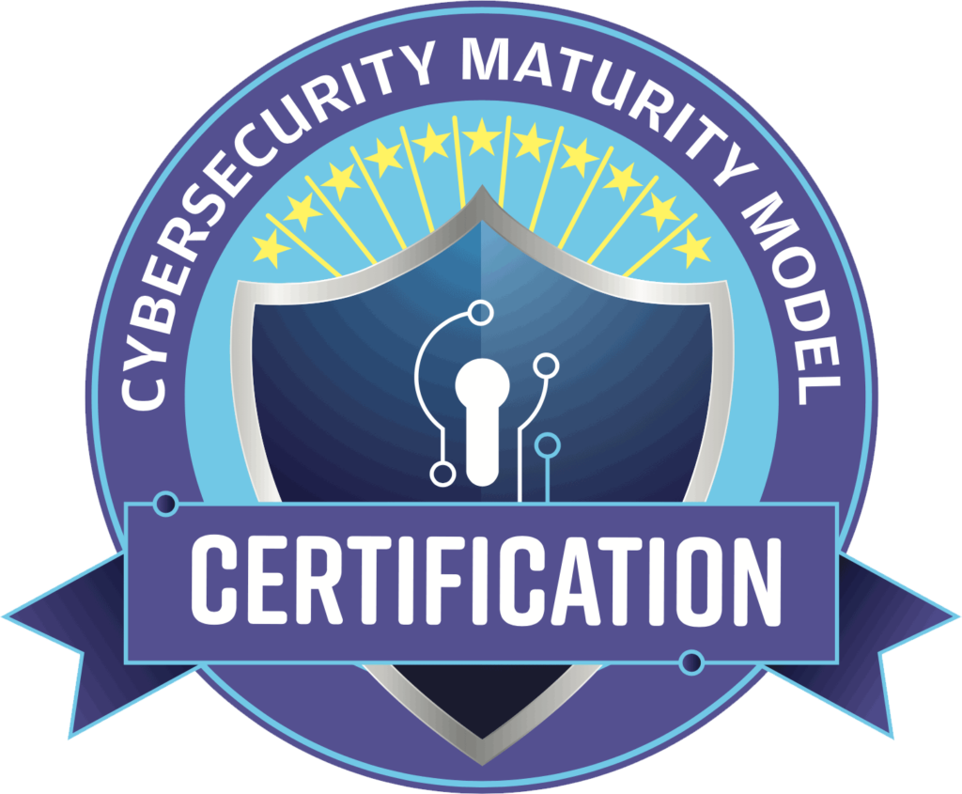
Cybersecurity Maturity Model Certification (CMMC)
Town Hall for JHU/APL Suppliers - May 5, 2026
Presented by:
Michael Connelly, Deputy Cybersecurity Compliance Program Manager / Classified Strategist
Valeree Combs, Procurement Manager
All Information contained herein is subject to change or update. Please utilize the website resources for the latest information at the end of this presentation.

Slide 2
Agenda
This slide deck is intended for informational and educational purposes only. For official guidance, please refer to CIO - Cybersecurity Maturity Model Certification.
Introduction to CMMC
CMMC levels
Implementation timeline
Conditional status
Annual affirmations
Self-assessment in the Supplier Performance Risk System, or SPRS (252.204-7012, 252.204-7019, 252.204-7020) vs. CMMC (252.204-7021)
Level 1 – Why it is obtainable (even for small businesses)
What is FCI anyhow?
Lessons learned in obtaining Level 2 - CMMC Third-Party Assessor Organization (C3PAO)
Working as a supplier with JHU/APL when CMMC is required per the contract
How to provide your organization’s CMMC eligibility to JHU/APL
Recommended Resources
Q&A

Slide 3



Cybersecurity Maturity Model Certification

Slide 4

CMMC
What: A consistent pre-award assessment methodology to determine whether a prospective contractor has implemented cybersecurity protections necessary to adequately safeguard Department of War (DOW) information.
Why: To increase the cybersecurity posture of the Defense Industrial Base (DIB) and better protect Federal Contract Information (FCI) and Controlled Unclassified Information (CUI).
How: All defense contractors and subcontractors will show compliance with applicable security requirements through self-assessment or independent assessment, prior to contract award (excluding Commercial-Off-The-Shelf [COTS] procurements).
Extracted from DOW CMMC 101 Briefing: https://dodcio.defense.gov/Portals/0/Documents/CMMC/CMMC-101-Nov2025.pdf

Slide 5
Defining CUI and FCI
Controlled unclassified information (CUI) is government-created or - owned unclassified information that allows for, or requires, safeguarding and dissemination controls in accordance with laws, regulations, or government-wide policies. It is sensitive information that does not meet the criteria for classification but must still be protected.
Federal contract information (FCI) is information, not intended for public release, provided by or generated for the government.
This does not include information provided by the government to the public (such as that on public websites) or simple transactional information, such as that necessary to process payments.

Slide 6
Existing DOW Cybersecurity Requirements
DFARS clause 252.204-7012 – Effective Oct 2016 (to be implemented NLT Dec 2017)
Safeguard DOW CUI that resides on or is transiting through a contractor/subcontractor internal information system or network by implementing NIST SP 800-171 at a minimum
Report cyber incidents that affect contractor/subcontractor ability to perform requirements designated as operationally critical
Does not require a specific Plan of Action and Milestones (POA&M) close-out date or a compliance assessment
DFARS Provision 252.204-7019 – Effective Nov 2020
Implement DFARS clause 252.204-7012 and have at least a NIST SP 800-171 self-assessment (Basic) that is current posted in SPRS (i.e., not more than three years old unless a lesser time is specified in the solicitation)
Does not require a minimum passing score
DFARS clause 252.204-7020 – Effective Nov 2020
Provide government access when necessary to conduct or renew a higher-level assessment
Include requirements of the clause in all applicable subcontracts and ensure applicable subcontractors can conduct and submit an assessment
CMMC assesses whether a prospective DOW contractor has implemented these standards.
Extracted from DOW CMMC 101 Briefing: https://dodcio.defense.gov/Portals/0/Documents/CMMC/CMMC-101-Nov2025.pdf

Slide 7
CMMC Applicability
CMMC Program requirements will apply to all DOW solicitations and contracts for which a defense contractor or subcontractor will process, store, or transmit FCI or CUI on its unclassified contractor information systems.
New DOW solicitations
New DOW procurement instruments, including contracts, task orders, delivery orders and their associated option periods
As a condition to exercise an option period
Subcontractors are subject to flow-down requirements
CMMC implementation will occur through new contracts awarded after 10 Nov 2025.
Incorporation in older contracts would require bilateral modification.
The CMMC Program does not alter separately applicable requirements to protect FCI or CUI.
Extracted from DOW CMMC 101 Briefing: https://dodcio.defense.gov/Portals/0/Documents/CMMC/CMMC-101-Nov2025.pdf

Slide 8
CMMC Implementation Through Contracts
DFARS clause 252.204-7021
Relies on the requiring activity to identify the appropriate CMMC Status requirements based on the type of information to be processed, stored, or transmitted
Implements CMMC Program requirements codified in 32 CFR Part 170, which include:
Minimum passing score of 80% (88/110)
Restriction of items that can be identified on a POA&M
Maximum 180-day POA&M close-out date
Annual affirmation of continued compliance in SPRS
Flow-down of requirements to subcontractors
The Effective Date for the Final CMMC DFARS Clause is 10 Nov 2025.
Extracted from DOW CMMC 101 Briefing: https://dodcio.defense.gov/Portals/0/Documents/CMMC/CMMC-101-Nov2025.pdf

Slide 9
Revised CMMC Framework Requirements
CMMC Model
Model
Assessment
134 requirements (110 from NIST SP 800-171 R2, plus 24 from NIST SP 800-172) | DIB Cybersecurity Assessment Center (DIBCAC) certification assessment every 3 years Annual Affirmation
110 requirements aligned with NIST SP 800-171 R2 | C3PAO certification assessment every 3 years, or Self assessment every 3 years for select programs Annual Affirmation
15 requirements aligned with FAR 52.204-21 | Annual Self Assessment Annual Affirmation
Level 3
Level 2
Level 1
When specified in a solicitation, all CMMC requirements must be met prior to award.
Extracted from DOW CMMC 101 Briefing: https://dodcio.defense.gov/Portals/0/Documents/CMMC/CMMC-101-Nov2025.pdf

Slide 10
CMMC Post-Assessment Remediation
CMMC Program will allow limited use of POA&Ms
POA&Ms are not allowed for CMMC Level 1.
Refer to §170.21 of the 32 CFR CMMC Program final rule for CMMC Level 2 and Level 3 POA&Ms requirements, including critical requirements not allowed in a POA&M.
Closeout Assessment
POA&M closeout self-assessment is conducted by the Organization Seeking Assessment (OSA).
POA&M closeout Certification Assessment is conducted by a C3PAO or the DIBCAC.
POA&Ms must be closed out within 180 days of when the CMMC Assessment results are finalized and submitted to SPRS or CMMC eMASS, as appropriate.
Failure to close POA&M within 180 days will result in an expired CMMC Status.
Extracted from DOW CMMC 101 Briefing: https://dodcio.defense.gov/Portals/0/Documents/CMMC/CMMC-101-Nov2025.pdf

Slide 11
Conditional and Final Status
An Organization Seeking Assessment (OSA) may achieve a Conditional CMMC Status if the initial assessment (with passing score) resulted in allowable POA&M items.
An Organization Seeking Certification (OSC) achieves a Final CMMC Status when assessment results in a passing score with no POA&M, or when the POA&M has been closed out within 180 days of achieving a Conditional CMMC Status.
Extracted from DOW CMMC 101 Briefing: https://dodcio.defense.gov/Portals/0/Documents/CMMC/CMMC-101-Nov2025.pdf

Slide 12
Phased Implementation of CMMC Requirements
Phase 1 - Initial Implementation
Phase 2
Begins 10 Nov 2025
Where applicable, solicitations will require Level 1 or 2 self-assessment
Phase 3
﻿﻿Begins 10 Nov 2026
﻿Where applicable, solicitations will require Level 2 Certification
﻿﻿DOW may opt to delay the Level 2 certification requirement in a contract to an option
Phase 4 - Full Implementation
﻿﻿Begins 10 Nov 2027
Where applicable, solicitations will require Level 3 Certification
DOW may opt to delay the Level 3 certification requirement in a contract to an option period
﻿﻿Begins 10 Nov 2028
All solicitations and contracts will include applicable CMMC Level requirements as a condition of contract award
DOW may implement CMMC Level 2 (C3PAO) requirements in some Phase 1 procurements or Level 3 requirements in some Phase 2 procurements, which may limit competitors or drive cost.
Extracted from DOW CMMC 101 Briefing: https://dodcio.defense.gov/Portals/0/Documents/CMMC/CMMC-101-Nov2025.pdf

Slide 13

Annual Affirmations (252.204-7021)
What it is An annual affirmation from a senior official that the organization continues to meet its required cybersecurity standards.
Who is responsible A designated senior official (e.g., corporate officer or equivalent) must provide the affirmation.
What is affirmed
Implementation of required security controls (per applicable CMMC level)
Accuracy of the organization’s cybersecurity status in SPRS
Continued compliance with safeguarding requirements for CUI
Frequency
At least annually after initial certification/assessment
Required to maintain contract eligibility
Where it is submitted
Supplier Performance Risk System (SPRS)
Why it matters
Demonstrates ongoing compliance (not just point-in-time)
Required for DOW contract awards and renewals
False affirmations carry legal and contractual risk

Slide 14
Clarifying Self-Assessment in SPRS vs. CMMC Level 2 (Self)
SPRS self-assessments (252.204-7019/7020) evaluate compliance with NIST SP 800-171 only, using a scoring methodology. CMMC Level 2 (Self) under 252.204-7021 also aligns to NIST SP 800-171, but is structured as a formalized program with defined assessment objectives and affirmation requirements.
Assessment rigor and structure: SPRS allows organizations to self-score and report gaps (POA&Ms permitted) with less formal validation. CMMC Level 2 (Self) requires a more standardized assessment against specific objectives, with stricter expectations on evidence and implementation.
Affirmation and accountability: SPRS submissions require score reporting but do not mandate annual senior official affirmation. CMMC Level 2 (Self) requires annual affirmation by a senior official, increasing executive accountability and legal risk.
Program intent and enforcement: SPRS is primarily a risk reporting mechanism for DOW visibility into contractor cybersecurity posture. CMMC introduces a compliance framework tied directly to contract eligibility, emphasizing sustained compliance over point-in-time scoring.

Slide 15

FCI Determination Workflow
Is this information connected to a Federal Government contract?
NOT FCI
NO
YES
Was it provided by the Government OR created for the Government?
NOT FCI
Remember FCI is NOT marked
NO
YES
Is it ONLY simple
transactional information?
NOT FCI
YES
NO
THIS IS FCI
Is the information intended
for public dissemination?
NOT FCI
NO
YES

Slide 16
What Changes: Level 1 - FCI
The contractor must implement all 15 (or often cited “17”) cybersecurity practices dictated in FAR 52.204-21(b)(1) to safeguard FCI.
NOTE: The Final Rule does not allow deferral via a POA&M for those 15 practices.
Contractors must update their SPRS CMMC information to affirm compliance with all 15 controls.
In order to be contract eligible and in good standing, contractor needs to:
Perform a self-assessment and load score in SPRS; and
Submit an annual affirmation of compliance.
Once contract is awarded, contractor must maintain an unexpired SPRS score and affirm annual compliance.
Assessment is information system focused.
Each information system will have a unique ID number and must be individually assessed / certified.

Slide 17
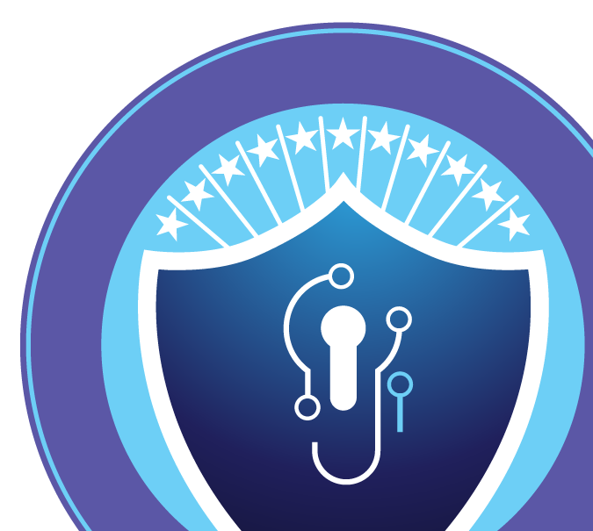
JHU/APL Lessons Learned for a Level 2 – C3PAO
Resources
Consider hiring a Managed Service Provider (MSP) to provide consulting.
Join an industry community to learn best practices.
Scoping
Limit where CUI will be processed, stored, or transmitted as much as possible.
Where is your data going?
Interview members of your company to understand how they handle CUI data.
Create a “Data Flow Diagram.”
SSP Writing
Write your System Security Plan (SSP) to the Assessment Objective Level.
Be detailed.
Write what you do and do what you say.
Create artifacts to back up your written documentation.
Hiring a C3PAO
Interview C3PAOs – ask them questions for how they assess areas of concern.
Request interviews.
Practice
Conduct practice sessions.

Slide 18
Working with JHU/APL
Procurement

Slide 19
Cybersecurity Maturity Model Certification Requirements / DFARS 252-204-7021
Government sponsors can and are adding the CMMC requirements to contracts:
New contracts
Exercised options
Existing contracts by bilateral modification
Until DFARS 252.204-7021 is added into a contract, nothing changes.
Once in JHU/APL’s prime contract we must flow-down the requirements to suppliers who will be required to receive, transmit, or generate FCI or CUI.
We cannot award a new Purchase Order (PO) or modification unless the supplier/subcontractor is CMMC compliant at the CMMC status level required per the contract.

Slide 20
Will CMMC Apply to my Purchase Order / Subcontract?
The CMMC requirement does not apply to Commercial Off-The-Shelf (COTS) suppliers, but does apply to:
Modified COTS suppliers (where any customization occurs)
Suppliers of commercial services that handle FCI or CUI
Subcontractors or suppliers of non-commercial items or services that handle FCI or CUI
Your organization’s CMMC compliance level will be asked as part of the Request for Proposal (RFP)/Request for Quotation (RFQ) and confirmed prior to award.
JHU/APL’s terms & conditions require you to maintain your compliance (i.e., annual affirmation) and notify us immediately if there is any lapse.

Slide 21
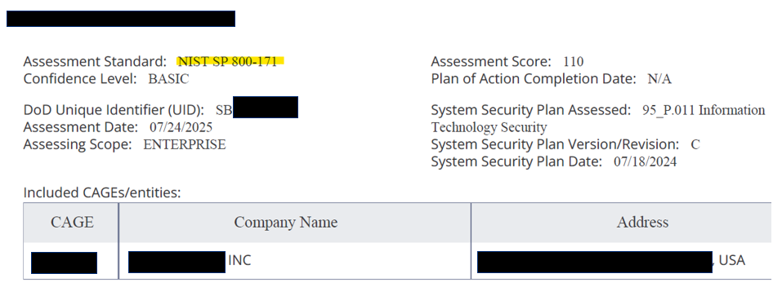
Not Eligible for CMMC - Example

Slide 22
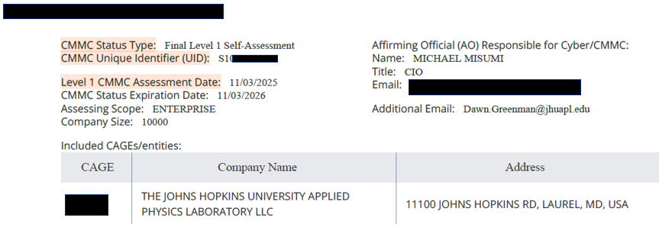
CMMC Level 1 – Example

Slide 23
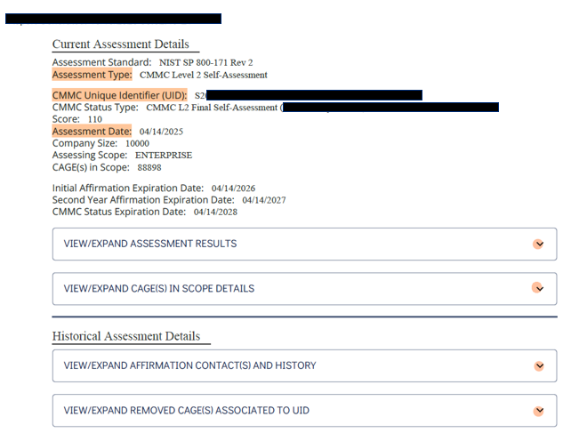
CMMC Level 2 – Self Example

Slide 24
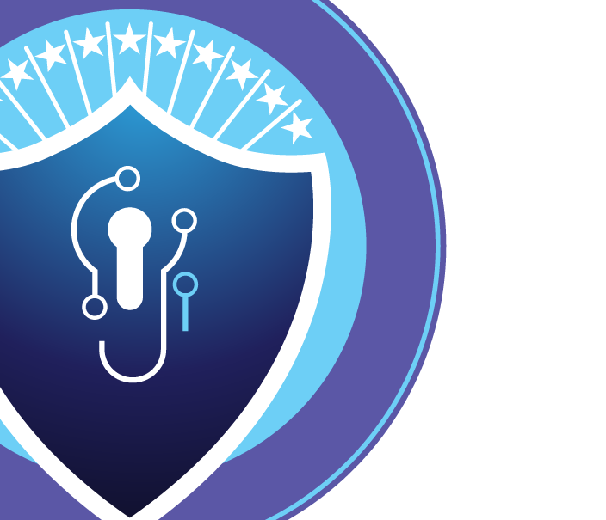
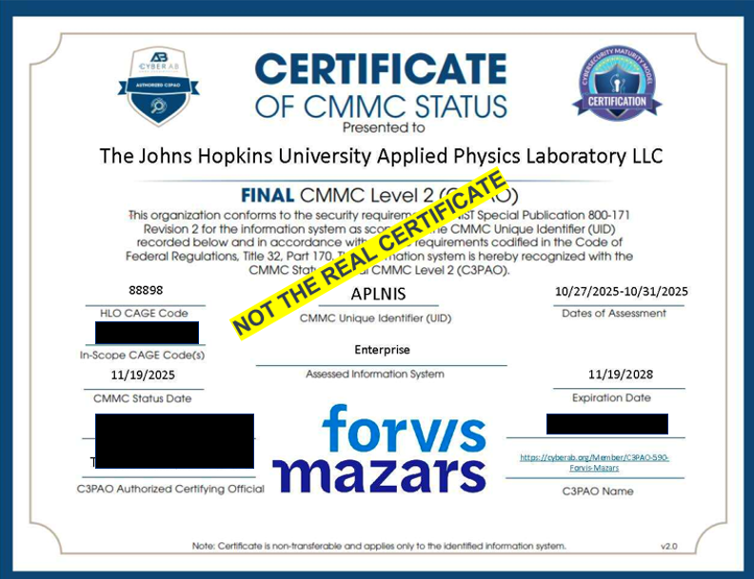

Slide 25
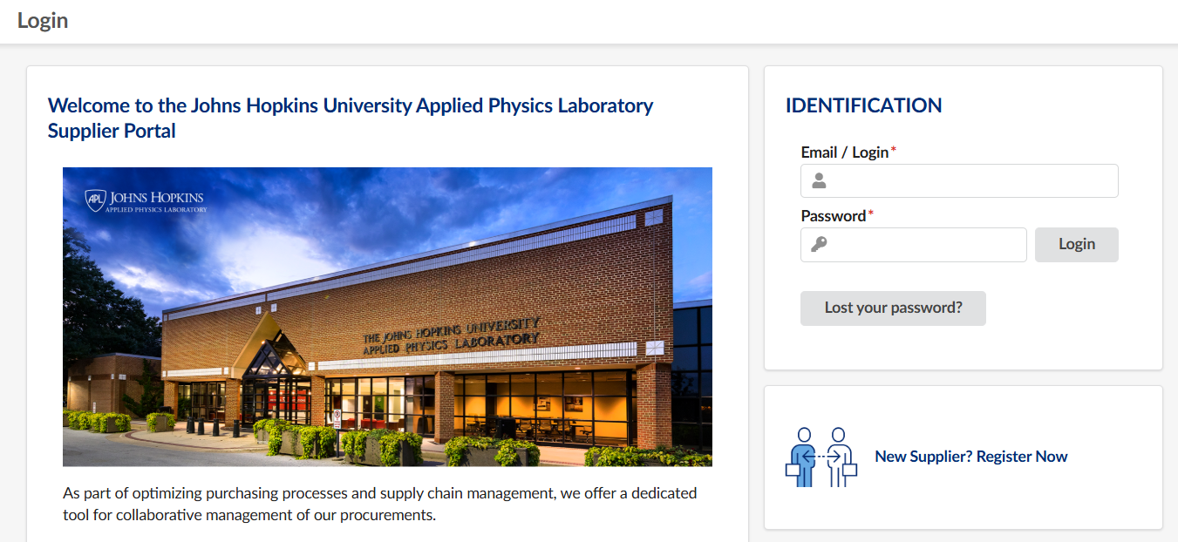
JHU/APL Supplier Portal Demo
Contact your Procurement Representative for access to the Supplier Portal or email +BCFD CMMC Suppliers.

Slide 26

JHU/APL CMMC Hotline
We understand preparing for CMMC may result in questions. If questions arise, please contact us to speak with a member of our cybersecurity compliance team. One of our experienced staff members will reach out within two business days, during normal business hours (Monday to Friday, 8 a.m. to 5 p.m. ET, excluding federal holidays).
To reach a cybersecurity expert, contact +smb-cyber@jhuapl.edu
Please include the following information:
Company name, industry, and website address
Business size (e.g., small business) and socioeconomic classification
Whether you are a current or previous supplier for APL
Contact information
Specific question or resource information you are looking for
SPRS Tutorial: https://www.sprs.csd.disa.mil/cmmc.htm

Slide 27
JHU/APL Supplier Webpage & Procurement Contacts
Supplier Main Website:
Suppliers | Johns Hopkins University Applied Physics Laboratory (https://www.jhuapl.edu/work/partnerships/suppliers)
Cybersecurity Resource Page:
Cybersecurity Information for Suppliers | Johns Hopkins University Applied Physics Laboratory
(https://www.jhuapl.edu/work/partnerships/suppliers/cybersecurity)
JHU/ APL Procurement Contacts:
JHU/APL Procurement Group – Specific to CMMC
BCFD-CMMC-Suppliers@jhuapl.edu
JHU/APL Procurement Group – Small Business Liaison Office (SBLO)
PartnerandSupplierResources@jhuapl.edu

Slide 28
Additional Resources
The DOW CIO CMMC website houses a broad range of resources, including CMMC scoping and assessment guides: https://dodcio.defense.gov/cmmc/Resources-Documentation/
To locate certified CMMC assessors, trainers, and instructors that companies can engage now to prepare for CMMC implementation, visit the CMMC Accreditation Body Marketplace: cyberab.org/marketplace
The Defense Acquisition University offers free online CMMC training: https://www.dau.edu/courses/cyb-1010 & https://www.dau.edu/courses/cyb-1030
Extracted from DOW CMMC 101 Briefing: https://dodcio.defense.gov/Portals/0/Documents/CMMC/CMMC-101-Nov2025.pdf

Slide 29
Additional Resources, Cont’d
DOW CUI Quick Reference Guide includes information on the marking and handling of CUI: https://www.dodcui.mil/
﻿﻿To find a FedRAMP Moderate Authorized Service Provider, please visit: https://marketplace.fedramp.gov/assessors
﻿﻿DOW's Office of Small Business Programs has compiled a list of resources that are aimed at helping small and medium-sized businesses understand security requirements and reach compliance: https://business.defense.gov/Resources/FAQs/
﻿﻿Additional cybersecurity resources:
https://www.cisa.gov/shields-up
https://www.nist.gov/mep
https://www.apexaccelerators.us/#/
Extracted from DOW CMMC 101 Briefing: https://dodcio.defense.gov/Portals/0/Documents/CMMC/CMMC-101-Nov2025.pdf

Slide 30
Additional Resources, Cont’d
Warfighting Acquisition University (formerly DAU) Microlearnings
Technical:
Operational Plans of Action versus Plan of Action and Milestones (POA&Ms) - (11:34 mins)
CMMC - Understanding an SSP | www.dau.edu (10:45 mins)
Acquisition Contract Info (How Gov is training their contracting officers and program managers):
CMMC Phased Implementation | www.dau.edu (13:45 mins)
CMMC Level Determination - Memo on DoD CMMC level assignment, incl. Phase 1 ban on Level 3. (8:19 mins)
CMMC and Contracting Teams – The Short Version (DAU Media): A primer on CMMC 2.0, covering CUI, FCI, and assessment levels. (14:32 mins)
Understanding CMMC Flow Down Requirements | www.dau.edu
CMMC Level 1 - Comprehensive Video (2hr 39mins) - cover FCI and CUI definitions
Extracted from DOW CMMC 101 Briefing: https://dodcio.defense.gov/Portals/0/Documents/CMMC/CMMC-101-Nov2025.pdf

Slide 31
Questions?
This slide deck is intended for educational purposes only. For official guidance, please refer to CIO - Cybersecurity Maturity Model Certification
All Information contained herein is subject to change or update. Please utilize the website resources for the latest information at the end of this presentation.

